Slide 1
Time Series

Slide 2
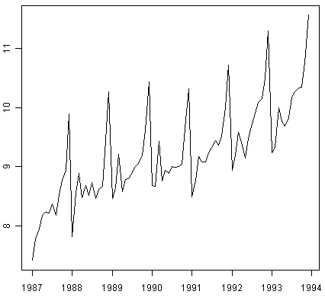
What is a time series data?
A time series is a sequence of data points, typically consisting of successive measurements made over a time interval.
They have an internal structure (such as autocorrelation, trend or seasonal variation) that should be accounted for.
Usage :
1) Obtain an understanding of the underlying forces that produced the observed data
2) Fit a model and proceed to forecasting
Economic Forecasting, Sales Forecasting, Stock Market Analysis, Inventory Studies, Workload Projections, Census Analysis

Slide 3
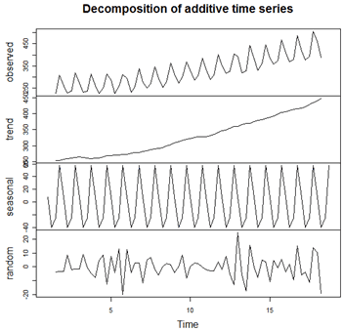
Components of time series data

Slide 4
Smoothing - Tackling the ‘VARIATIONS’
Inherent in the collection of data taken over time is some form of random variation. There exist methods for reducing of canceling the effect due to random variation.
There are two distinct groups of smoothing methods
Averaging Methods
Exponential Smoothing Methods

Slide 5
“Simple" average
The computed mean or average of the data = 10.
The manager decides to use this as the estimate for expenditure of a typical supplier.
Is this a good or bad estimate?
Supplier | Amount | Supplier | Amount
1 | 9 | 7 | 11
2 | 8 | 8 | 7
3 | 9 | 9 | 13
4 | 12 | 10 | 9
5 | 9 | 11 | 11
6 | 12 | 12 | 10

Slide 6
Error & Squared errors
Errors –
Absolute error (AE)
Mean Absolute error (MAE)
Mean Absolute % error (MAPE)
Squared errors-
Sum of squared errors (SSE)
Mean of sum of squared errors (MSE)
Root Mean of sum of squared errors (RMSE)
Notes:
If data has a lot of variations than RMSE helps to magnify that

Slide 7
Smoothing techniques
Simple Moving Average Method
Weighted Moving Average Method
Simple Exponential Smoothing Method
Double Exponential Smoothing Method
Triple Exponential Smoothing Method
Simple Moving Average Method – reduces the variations in the data.
Weighted Moving Average Method – more weight can be given to recent time periods
Simple Exponential Smoothing Method - exponential smoothing assigns exponentially decreasing weights over time. The largest weight is given to the present observation, less weight to the immediately preceding observation, even less weight to the observation before that, and so on (exponential decay of influence of past data).
Double Exponential Smoothing Method- takes care of smoothing and trend
Triple Exponential Smoothing Method- takes care of smoothing, trend and seasonality
Notes:
Simple Moving Average Method – reduces the variations in the data. Generate descriptive stats to show the reduction in variation and stddev.
Weighted Moving Average Method – more weight can be given to recent time periods
Simple Exponential Smoothing Method - exponential smoothing assigns exponentially decreasing weights over time. The largest weight is given to the present observation, less weight to the immediately preceding observation, even less weight to the observation before that, and so on (exponential decay
of influence of past data).
Double Exponential Smoothing Method- takes care of smoothing and trend
Triple Exponential Smoothing Method- takes care of smoothing, trend and seasonality

Slide 8
Autoregressive (AR) and moving average (MA)
Two basic types of time series models exist,
Autoregressive
Moving average models.
So, what’s the big difference?
The AR model includes lagged terms of the time series itself
The MA model includes lagged terms on the noise or residuals
How do we decide which to use?
ACF and PACF
AR(3),MA(2)

Slide 9
ACFs and PACFs
“The autocorrelation function (ACF) is a set of correlation coefficients between the series and lags of itself over time"
“The partial autocorrelation function (PACF) is the partial correlation coefficients between the series and lags of itself over time"
Notes:
"The PACF values are the coefficients of an autoregression of the series of interest on lagged values of the series" and I add where the PACF(K) is the coefficient of the last (kth) lag. Thus to compute the PACF of lag 3 for example compute
Yt=a0+a1Yt−1+a2Yt−2+a3Yt−3
and a3 is the PACF(3).

Slide 10
Autoregressive (AR) models
An autoregressive model of order “p” AR(p)
X _{t} = β₁ X _{t −1} + β₂ X _{t −2} + ... + β _{p} X _{t − p} + e_{t +} β₁e_{t −1} + β₂e_{t −2} + ... + β_{q} e_{t −q}
Current value of X_{t} can be found from past values, plus a random shock e_{t}
Like a multiple regression model, but X_{t} is regressed on past values of X_{t}
The AR(1) Model
A simple way to model dependence over time is with the “autoregressive model of order 1”
“This is a OLS model of X_{t} regressed on lagged X_{t-1}"
X _{t} = β₀ + β₁ X _{t −1} + e_{t}
“What does the model say for the t+1 observation?"
^{X} t +1 ^{= β}0 ^{+ β}1 ^{X} t ^{+ e}t +1
“The AR(1) model expresses what we don’t know in terms of what we do know at time t"

Slide 11
Moving-average (MA) models
“A moving-average model of order “q” " MA(q)
X _{t} = e_{t} + β₁e_{t −1} + β₂e_{t −2} + ... + β_{q} e_{t −q}
“Current value of X_{t} can be found from past shocks/error (e), plus a new shock/error (e_{t})"
“ The time series is regarded as a moving average (unevenly weighted, because of different coefficients) of a random shock series e_{t}"
The MA(1) model
“A first order moving average model would look like":
X _{t} = e_{t} + β₁e_{t −1}
If β₁ is zero, X depends purely on the error or shock (e) at the current time, and there is no temporal dependence
If β₁ is large, previous errors influence the value of X_{t}
If our model successfully captures the dependence structure in the data then the residuals should look random

Slide 12
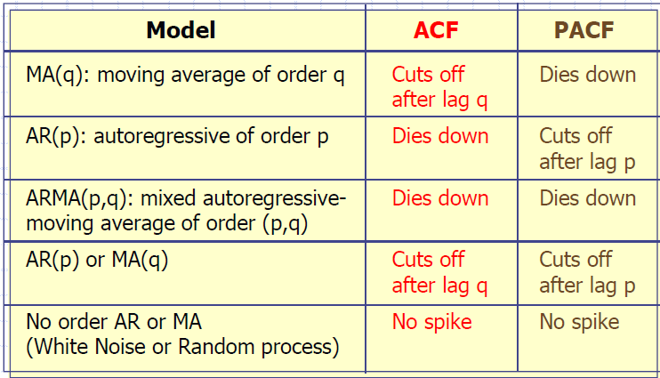
General Theoretical ACF and PACF of ARIMA Models

Slide 13
ARMA models
ARMA models are only suited for time series stationary in mean and variance
A mixture of these two types of model would be referred to as an autoregressive moving average model (ARMA)n,q, where n is the order of the autoregressive part and q is the order of the moving average term.
Mixed ARMA models "An ARMA process of the order (p, q)"
X _{t} = β₁X_{t −1} + ... + β _{p} X_{t − p} + α₁e_{t −1} + α₂e_{t −2} + ... + α_{q} e_{t −q}
"Just a combination of MA and AR terms"
"Sometimes you can use lower-order models by combining MA and AR terms"
"Lower order models are better!"
What If there is Trend and Seasonality ?? --- Will discuss

Slide 14
ARIMA Model
"Type of ARMA model that can be used with some kinds of non-stationary data"
"Useful for series with stochastic trends  First order or “simple” differencing"
Series with deterministic trends should be differenced first then an ARMA model applied
"The “I” in ARIMA stands for integrated, which basically means you’re differencing"
The ARIMA Model - Typically written as ARIMA(p, d, q) where:
"p is the number of autoregressive terms"
"d is the order of differencing"
"q is the number of moving average terms"
e.g. ARIMA(1,1,0) is a first-order AR model with one order of differencing
Which ARIMA(p,d,q) model do I use?
Plot the data.
Look to see if the data is stationary, that is they are scattered randomly about a constant mean level. Also look at the ACF and PACF (stationarity is implied by the ACF or PACF dropping quickly to zero).
If there is non-stationarity, such as a trend (we’re ignoring seasonal behavior for the moment!), difference he data. Practically, at most two differences need to be taken to reduce a series to stationary. Verify stationarity by plotting the differenced series and looking at the ACF and PACF.
Once stationary is obtained, look at the ACF and PACF to see if there is any remaining pattern. Check against the theoretical behavior of the MA and AR models to see if they fit. This will give you an ARIMA model with either no MA or no AR component i.e. ARIMA(0,d,q) or ARIMA(p,d,0).
If there is no clear MA or AR model, an ARMA model will have to be considered. These can in general not be guessed from the ACF and PACF, other methods are needed, based on the ideas of minimizing Information Criterion (AIC or BIC).

Slide 15
Seasonal ARIMA Model
ARIMA models cannot really cope with seasonal behavior. Hence we introduce seasonal ARMA model denoted by ARMA (P,Q)h. Seasonal ARMA can be of two types-
Seasonal ARMA (ARMA (p,q)) – Only seasonal components
Mixed seasonal ARMA (ARMA(p,q)(p,q)s. Combination of normal ARMA and seasonal ARMA.
In case trend and seasonality both are present. We will use ARIMA model instead of ARMA. The idea behind the seasonal ARIMA is to look at what are the best explanatory variables to model a seasonal pattern.
You can use ACF and PACF to identify P or Q:
For ARIMA(0, 0, 0)(P, 0,0)s , you should see major peaks on the PACF at s, 2s, ....Ps. On the ACF, the coefficients at lags s, 2s, ....Ps, ... should form an exponential decrease, or a damped sine wave.
ARIMA(0, 0,0)(0,0,Q)s , you should see major peaks on the ACF at s, 2s, ....Qs. On the PACF, the coefficients at lags s, 2s, ....Qs,... should form an exponential decrease, or a damped sine wave.
Using the AIC as the selection criterion, we select the ARIMA model with the lowest value of the AIC.

